Slide 1

CHERRY: Dynamic Cache Management For Fast-Efficient Start-up in PMEM Based FaaS System
SangHyeon, Eum
Hyunjoon, Jeong
2021 / 06 / 10
Notes:
Good afternoon, I’m first presenter 현준
Our project is dynamic cache management for fast-efficient startup in PMEM based FaaS system, just called simply “Cherry”

Slide 2
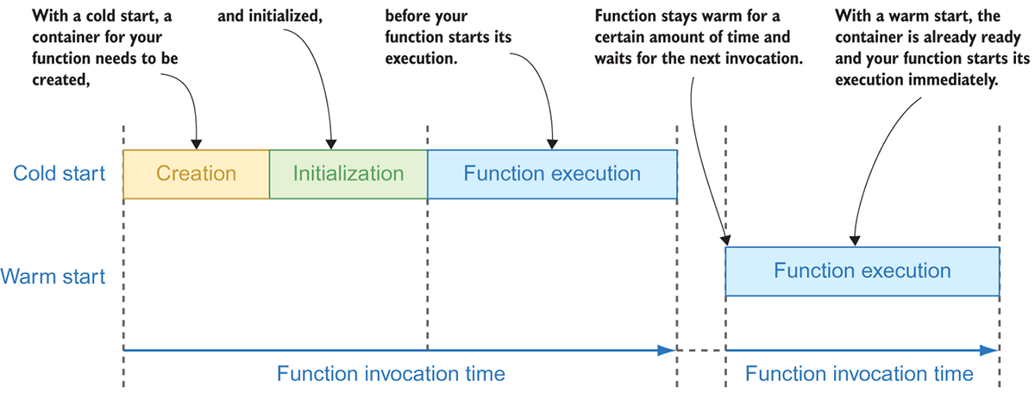
I. Motivation
Long Latency is facing challenge in serverless computing
Due to the container cold start overhead
Vendor usually provides warm-start solution
But this is quite expensive in cloud system
Notes:
Before introducing our system, let’s briefly remind our motiviation.
Previous proposal, we pointed out cold-start time, which occupy quite huge time in function invocation.
So, we want to reduce this overhead when container runs initially.

Slide 3
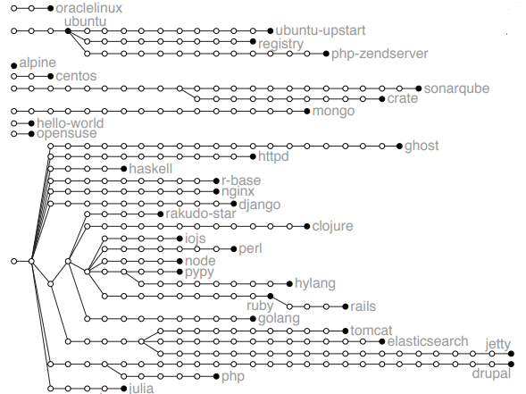
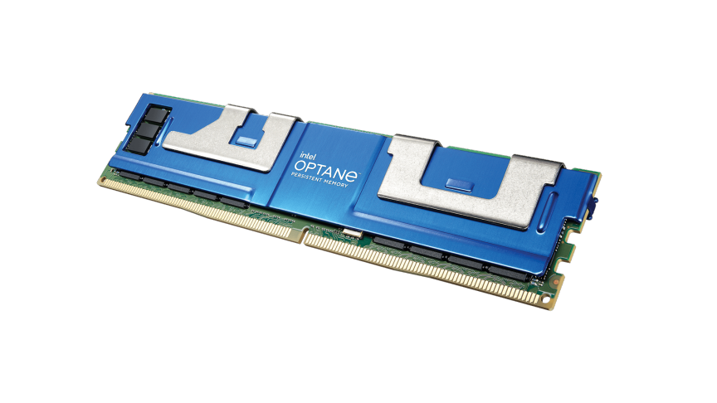

II. What we did?
Cache common layers of Docker images in PMEM
Dynamically use PMEM by policy
OR
Notes:
From motivation, we adopted PMEM for caching layers for solving problem.
Since PMEM is scarce resource, we also need efficient usage for PMEM.
So, to cache common layers and efficient PMEM usage, these two things were our goals.
To achieve them, we developed Cherry system.

Slide 4


III. CHERRY system
Run containers or pull images
Manager catch upcoming containers or image and check priority
Cache Manager
PMEM Monitor
PMEM monitor gives information about usage state of PMEM
CHERRY system
Notes:
This is overview of Cherry system.
It consists of two module called Cache manager and PMEM monitor.
When client requests container running or pulling images to docker, cache manager tries to cache or evict layers by policy.
PMEM monitor supports cache manager by providing PMEM information.

Slide 5
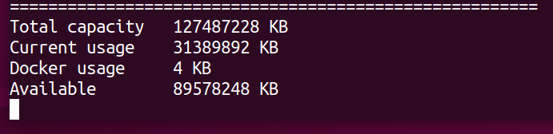
III. CHERRY system
PMEM monitor
Daemon monitoring mode
PMEM monitor create information of docker usage in PMEM.
It depends on Linux disk usage command.
Two mode : embedded mode, daemon monitoring mode
For docker caching system, embedded mode used.
It should require limitation parameter for how many capacity docker can be used in PMEM (default 10GB)
Notes:
As forementioned, PMEM monitor provides current information of PMEM such as total capacity or docker usage and so on.
It supports two mode, one is daemon monitoring mode like right figure.
The other is embedded mode, which can be used in real python code.
To use embedded mode, it requires limitation of PMEM, which means the maximum usage line for docker.
For example, if this limit set 10GB, docker only cache their layers up to 10GB in PMEM.

Slide 6
III. CHERRY system
Cache manager
Cache Manager
Both image list and container list inspect docker API, get their information and store each information as objects
Image list
Container list
Docker encode layer path to sha256 hash.
So, we need dictionary to match hash with real layer path
Layer path dictionary
Policy
operation
methods
When specific layer was cached, cache list store its information with its priority.
So, it helps faster access and eviction.
Cache list
Notes:
In cache manager, there is layer path dictionary to decode hash code of docker layer.
In docker, all layer name is coded by SHA hash, so that path of real layer directory is hidden.
Since we depends on linux command for decoding path, we had to use dictionary for faster searching.
In case of cache list, it classifies cached layers from image list and container list.
Of course, image list and container list stores each information as objects, and this is provided by docker API.

Slide 7
III. CHERRY system
Caching of CHERRY
Layer is shared by several images
Get higher priority
Layers in containers has called frequently
Docker image
NVMe or SSD
PMEM
Layer | Priority
L1 | 3
L2 | 1
L3 | 1
L1 inode
L1 inode
cache
L1 data blocks
L1 data blocks
Docker may try to access inode of original storage
Notes:
Now, we will introduce about Cherry caching mechanism.
The basic idea of caching policy is, the more sharing layer and calling layer frequently, the layer will get higher priority.
(애니메이션) For example, if layer L1 shared in three different images, it will get priority three.
So, the L1 will move data blocks from original storage to PMEM, then manager modifies inode to link PMEM cached path.
(애니메이션) When docker try to access original inode layer, it will lead to PMEM.
Since docker does not support several storage path for image, we had to modify inode of layers for caching.

Slide 8
III. CHERRY system
Evicting of CHERRY
CHERRY do eviction only when PMEM has no enough capacity for docker layer
PMEM
New layer want to cache
L4 | 4 | 400MB
Layer | Priority | size
L1 | 3 | 500MB
L2 | 1 | 300MB
L3 | 1 | 200MB
Cache Manager
Evict
L2 and L3
Notify to manager
“docker usage is full”
PMEM Monitor
Limit = 1GB
Notes:
This is eviction mechanism of Cherry.
Cherry only execute evicting operation, when PMEM monitor tells that docker usage of PMEM meet pre-defined limitation parameter.
That is, PMEM has no enough capacity for docker layer caching.
Let assume there are layers L1,2,3 in PMEM and its limitation was set to 1GB.
(애니메이션) When new layer L4, PMEM cannot cache it because it is already full, (애니메이션) so that the monitor module notify it to manager.
(애니메이션) Then, the manager start to evict layers from the lowest one until PMEM retains enough capacity.
So, in the figure case, L2 and L3 will evict and L4 will cache into PMEM.

Slide 9
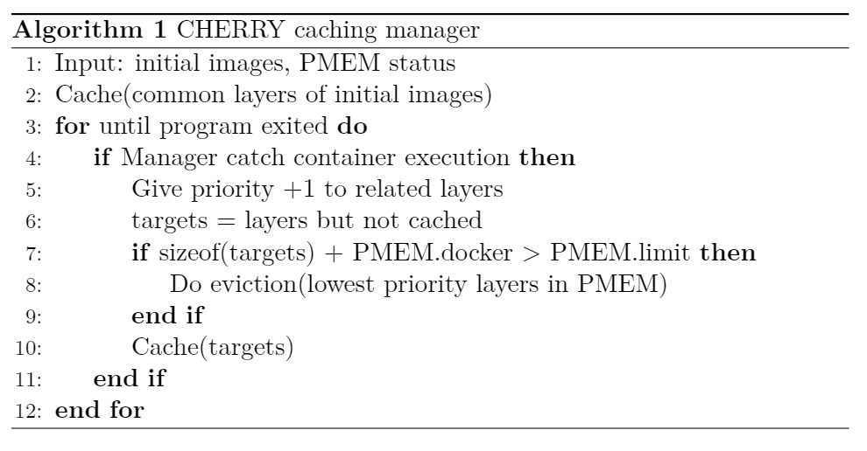
III. CHERRY system
Policy pseudo-code of CHERRY
Notes:
This is pseudo-code of Cherry policy.
As forementioned, manager catch docker’s status immediately in line 4.
Then, it gives priority to layers of executed container and check whether PMEM can cache or not.
This is operation from line 5 to line 7.
This algorithm can be also applied in pulling images by just modifying line 4.

Slide 10

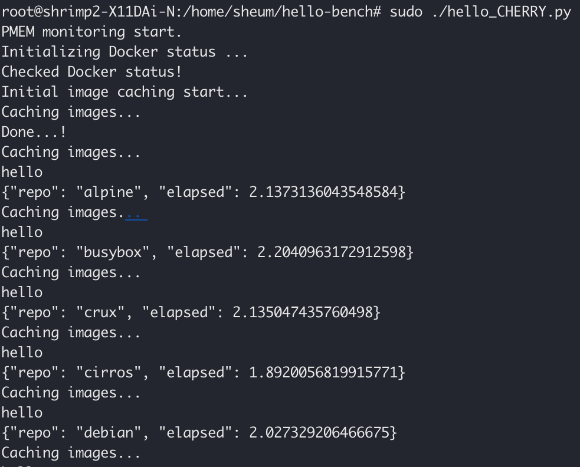
III. CHERRY system
Real execution (with hello-bench)
Manager has also two mode
Embedded mode
Daemon process mode
Manager catches executed container or pulled images.
After finish them, it does cache operation
Notes:
This is real execution figure of Cherry.
Like PMEM monitor, it supports two mode: embedded mode and daemon process mode.
To use embedded mode, we just imports and start in target code like above figure.
The other mode runs in background like system daemon, so that it can catch container execution and try caching operation immediately.
Next presenter 상현 will introduce about our experiments.

Slide 11
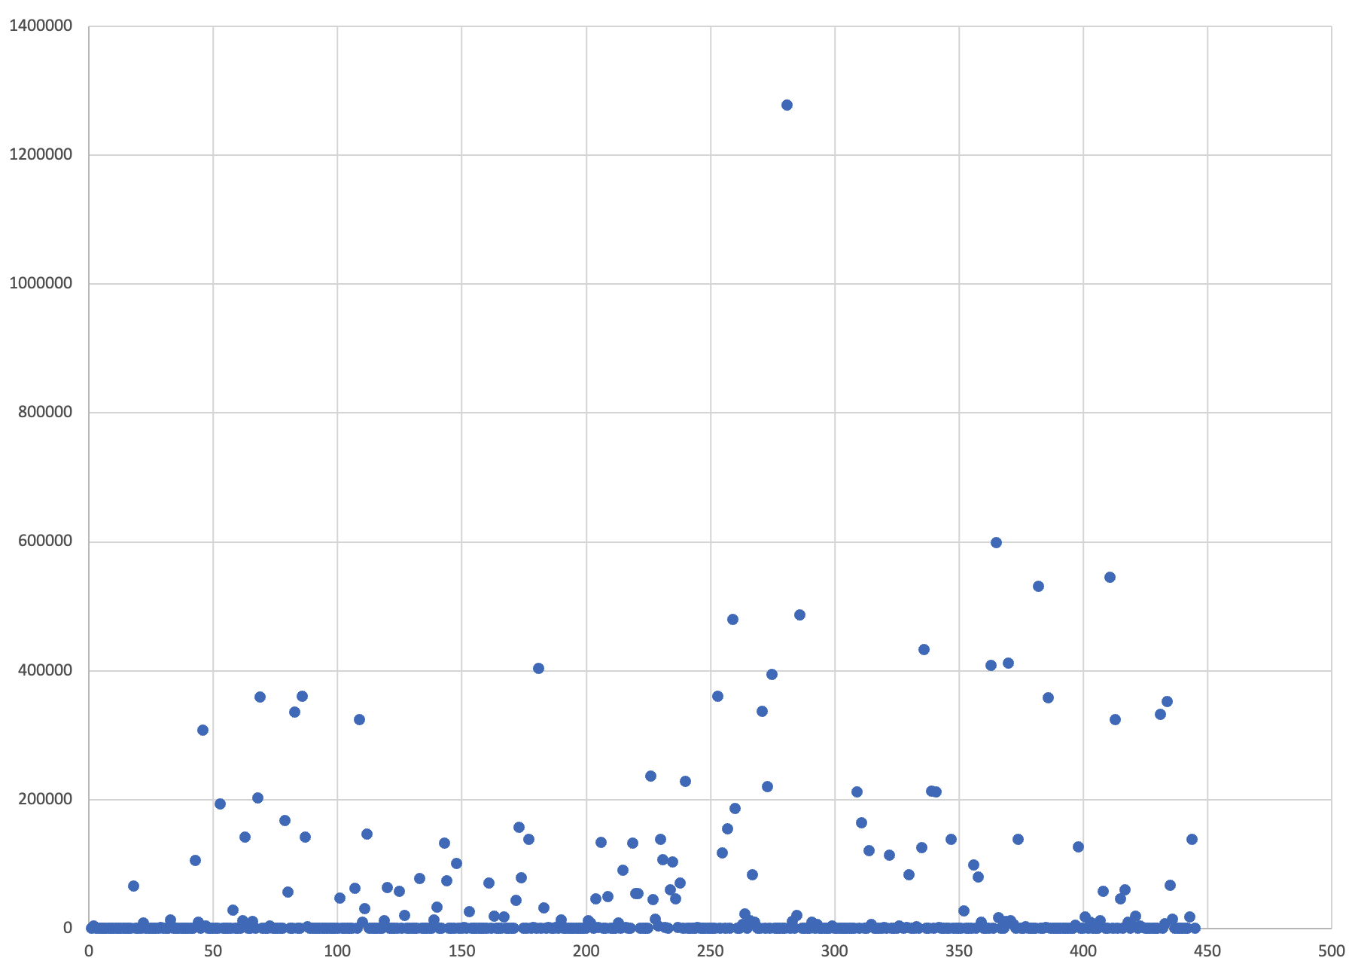
IV. Experiment
Methodology
Workload : Hello-Bench (Modified)
TestBed : Shirmp2 Server
PMEM : intel optane persistent memory 128GB
NVMe SSD : SAMSUNG 970 PRO
Hello-Bench
Consist of variety Workload
57 different containerized applications
550 node layers and 19 root layers.
We execute hello-bench in two time in one experiment. One for cache, the other for measure latency
- Layer Size (totally 20.2GB)
Notes:
This slide explain how we experiment!
We use Shimp2 server for experiment, which have intel optane persistent memory AND Samsung NVMe SSD
Workload is modified hello-bench. it is benchmark program for measuring Startup latency. we add caching thread for our experiments
Hello bench consist of 57 applications. And container images have 550 layer and 19 root layers.
We execute hello-bench in two time in one experiment. One for cache, the other for measure latency.

Slide 12
IV. Experiment
Linux Distro (Ubuntu)
Notes:
This is the result of Ubuntu Container. We cut off the latency in half.
The bar on the left-most shows nvme only. Right-most bar is pm only.
And the bar which labeled with cache is system that each capacity applied.
The reason for such a result is that cached layers have a significant impact on latency.

Slide 13
IV. Experiment
Language (clojure)
Notes:
This graph also obtained similar result. As the cache size increases, the latency decreases because the layer that affects latency is located in the PM.

Slide 14
IV. Experiment
DataBase (MySQL)
Notes:
The case of mySQL container is different. Increasing the caching layer does not improve performance, but increases latency.
Through this, we found that there is an overhead for the cache,
Also, the layer that affects startup should be cached, not just shared a lot.

Slide 15
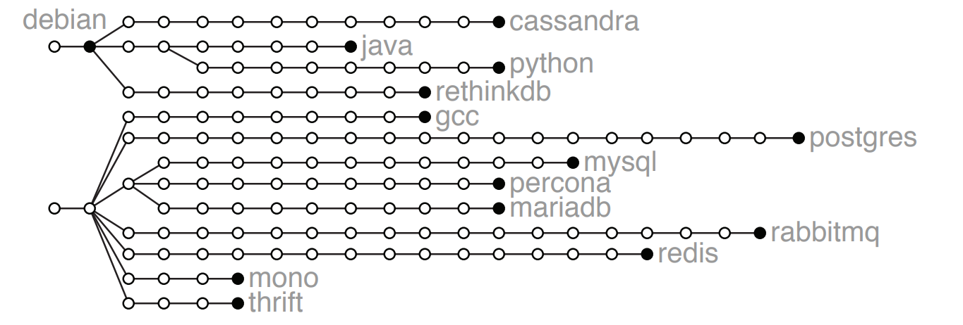

IV. Experiment
DataBase (MySQL)
Notes:
Simply, we cached the layer in red Rectangle, but blue one is real overhead in startup.

Slide 16
IV. Experiment
Startup Latency (ALL)
126 sec
122 sec
122 sec
Notes:
This graph shows the overall startup latency in hello-bench
Overall performance improved a bit.
As we said earlier, since we cached a lot of shared layers, there is a high probability that the layer which affects the startup time is still in nvme.

Slide 17
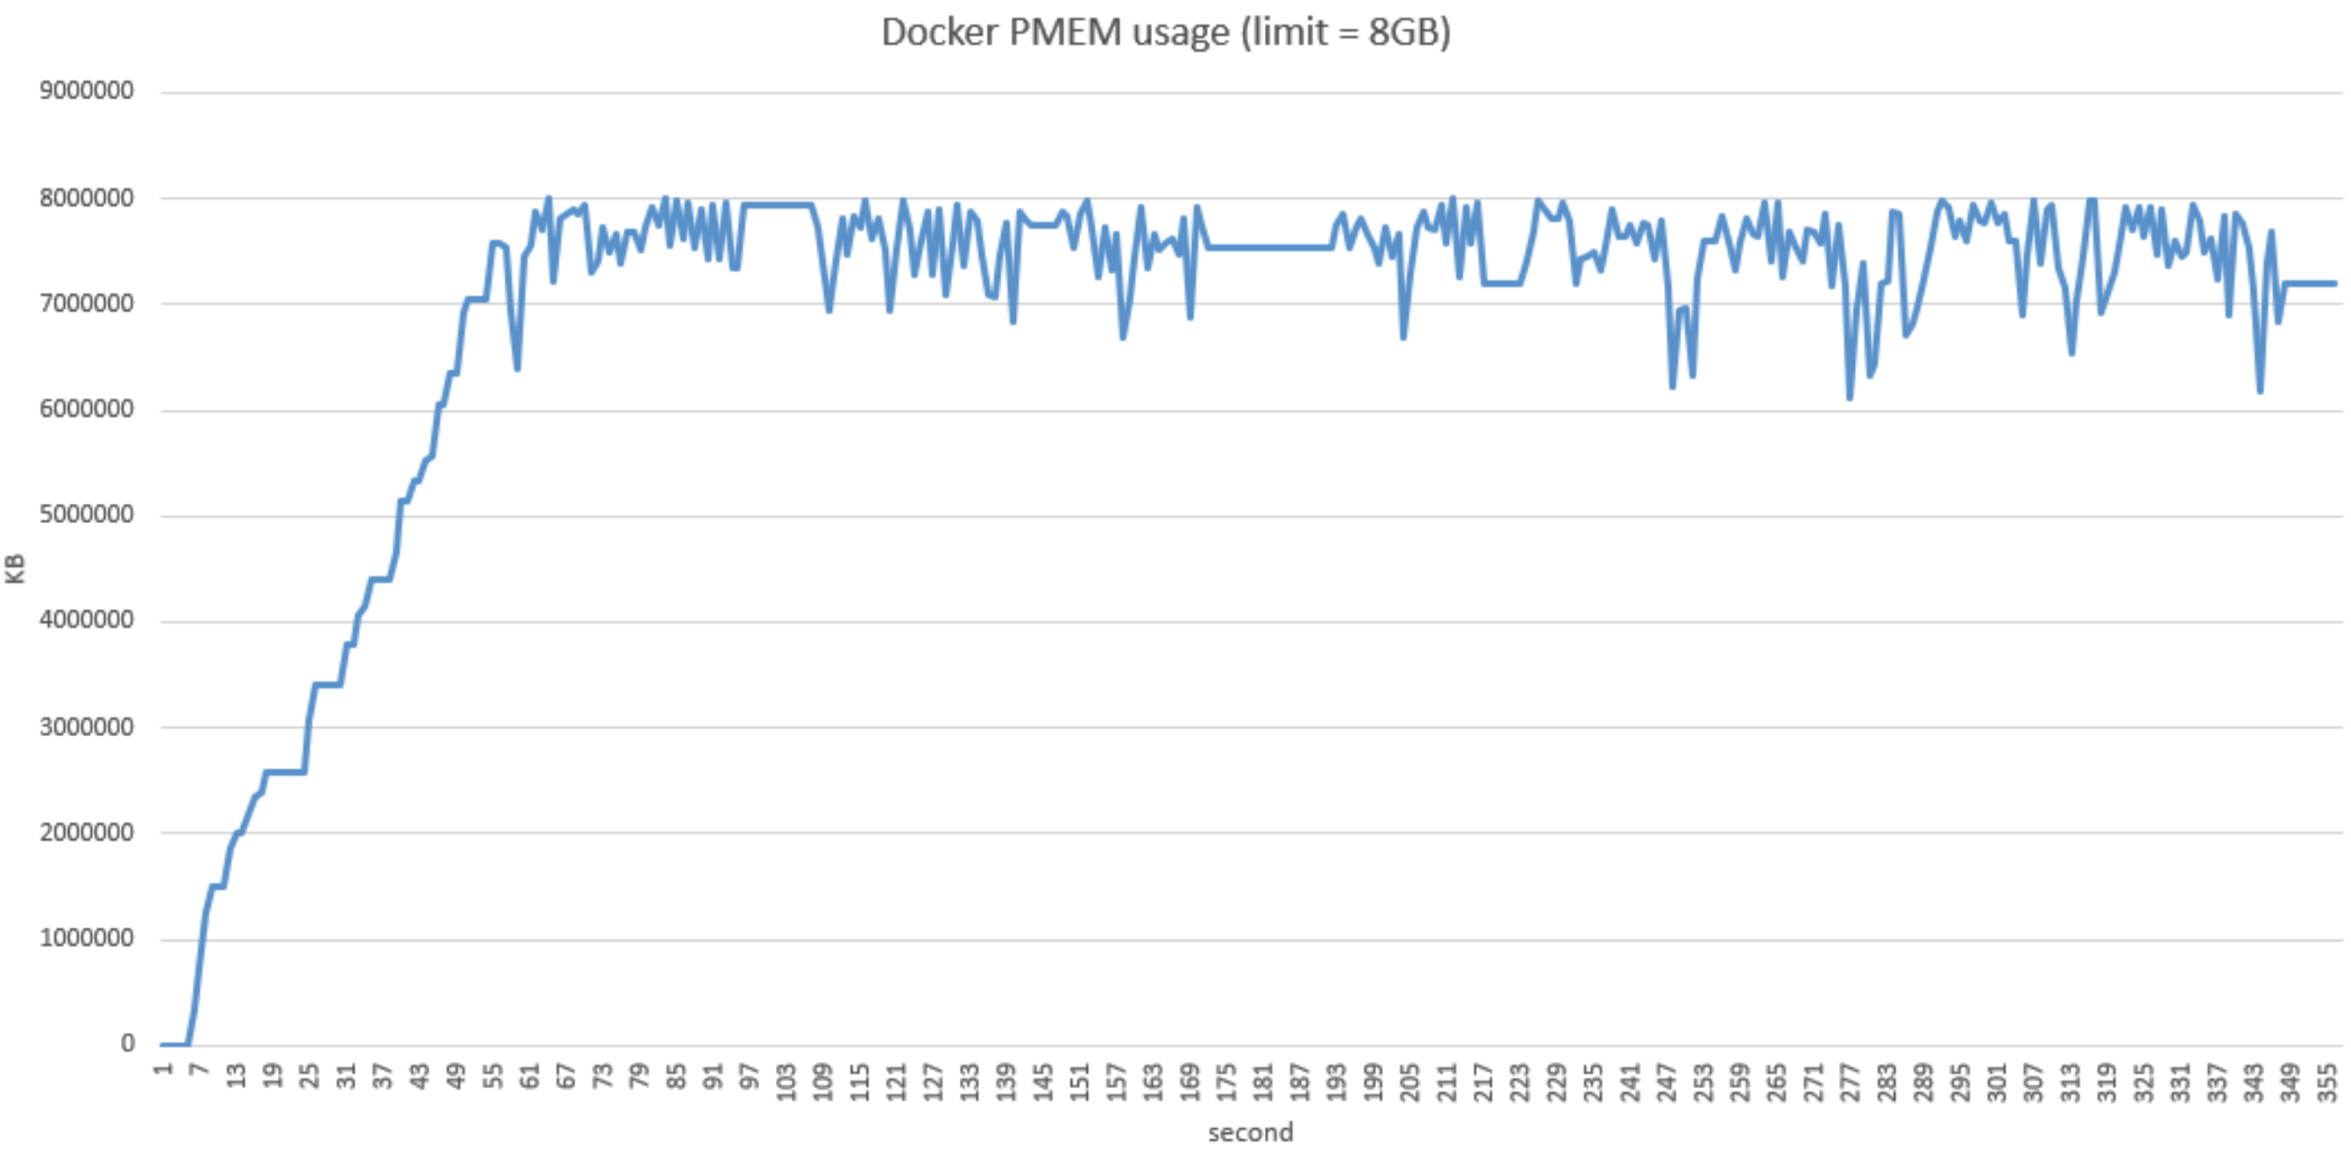
IV. Experiment
Cache usage
Start to come containers
Initialization
Notes:
This graph is for pm utilization. We set 8GB limitation for caching, and executed hello-bench containers.
After initialization, PMEM usage fluctuated between 6GB to 8GB.
Although our caching policy is simple, it shows good utilization.

Slide 18
V. Conclusion
Insight
Caching itself worked, But weak
Layers that have a high impact on performance exist in image.
Future Work
Better caching policy (e.g. consider layer executing latency)
Improve caching overhead
Redesign Docker image storage structure
Notes:
In conclusion, caching the shared layer itself was effective, but it was weak.
We got an insight that there was a separate layer that affected the performance.
Therefore, a better policy is needed to reduce Startup as future work. For example, there is a way to consider layer execute latency.
And we need to reduce the cache overhead. Since the union file system that stores Docker's image layer does not support persistent memory, it is also necessary to redesign it.
Moreover, we thought some other drawbacks about this system, but not organized yet, so we will point out later in our report.

Slide 19


Thank you

